Slide 1



Assignment
1. Complete the Quick Write Activity in your packet.
2. Complete the Google Classroom Assignment Posted on Google Classroom: Profit and Loss Digital Math Activity

Slide 2

Earning a profit is not necessary for an organization to be considered a business. Just the pursuit of profit makes an organization a business

Slide 3
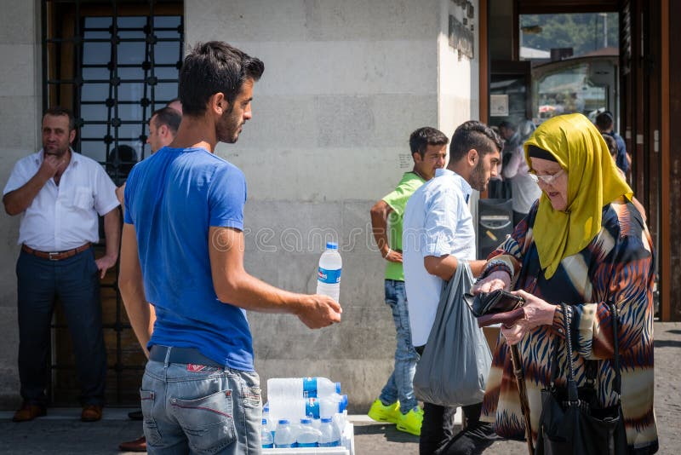

In addition, an organization does not need to have a physical store, or even a website, to be considered a business
A person selling water outside on a hot day is doing business, as they are offering a product in exchange for a profit
A self-employed worker who offers their video editing skills on a freelance basis could be a business within themselves

Slide 4

What are the Benefits of Business in Society?
Businesses Create:
Job creation
Drive innovation and new technological advancement - improves the quality of life and enhance productivity
Create wealth for their owners, shareholders, and employees (moves the economy)
Offer a wide range of products for lower prices
Support various social and environmental causes

Slide 5

What are the Drawbacks of Business in Society?
Some businesses can have:
  a negative environmental impacts, such as pollution and greenhouse gas emissions
  Poor working conditions, inadequate wages, or unethical labor practices
  Sale of products that are hazardous
  Engage in unethical behavior, such as tax evasion and corporate scandals
  Large businesses can have significant market power, leading to a monopoly that hinders fair competition and limits consumer choices

Slide 6
Quick Write Activity
Read the article exert below and answer the question in your packet:
Texas Attorney General sued General Motors Tuesday, alleging the carmaker illegally collected and sold drivers’ data to insurance companies
In car models from 2015 and later, the Detroit-based car manufacturer allegedly used technology to “collect, record, analyze, and transmit highly detailed driving data about each time a driver used their vehicle,”

Slide 7
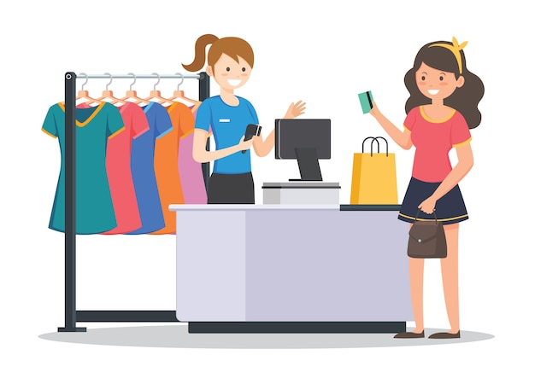

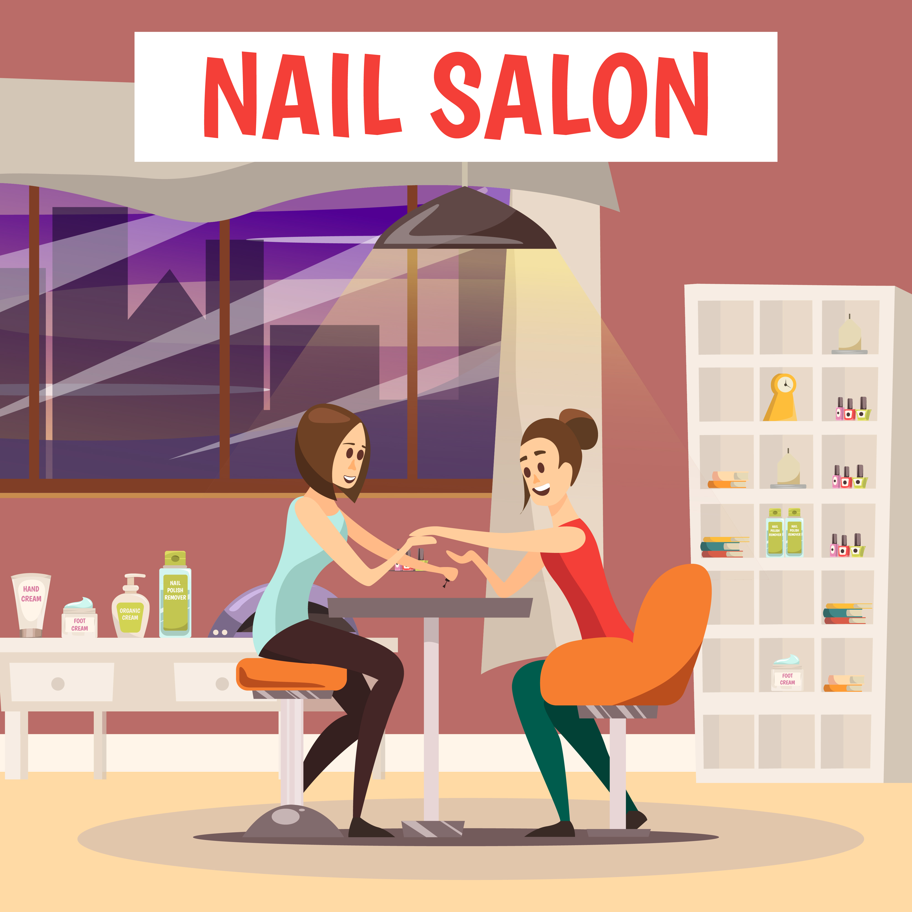
Types/Categories of Businesses
There are many types of businesses, and it is common for businesses to operate in multiple areas simultaneously. But there are four main categories of FOR PROFIT businesses.

Slide 8
Manufacturing
a business that develop a product and sell it either directly to the customer or to some type of middleman, like a wholesaler or retailer
Merchandising
also known as retailing,
Products are purchased from manufacturers, wholesalers, or other middlemen, and are sold at the retail price to the consumer
Sell products at a price higher than what they paid to purchase to earn a profit
Service Business
Sell intangible goods to consumers. They are paid to do something for the customer. They offer professional services, expertise, and various other offerings.
Hybrid
Businesses that possess the qualities of multiple business types. They can be a manufacturer, merchandiser, and/or service business.
Four Main Types of Businesses Include

Slide 9
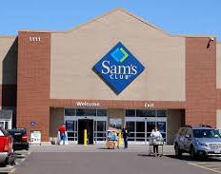
Example: Sam’s Club
manufactures its own line of products branded Member’s mark
They sell their products and products from other manufactures/wholesalers
Offers a variety of services including health care services, travel, auto maintenance etc.

Slide 10

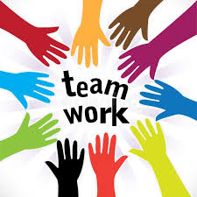
Directions:
From the List of well-known companies provided by your instructor, determine whether each is predominately a manufacturing, merchandising, service, or hybrid business. If it is hybrid, state which two or three types it is.

Slide 11
Table Talk Group Activity: Types of Businesses
Directions: Given the list of well-known companies, determine whether each is predominately a manufacturing, merchandising, service, or hybrid business. If it is hybrid, state which two or three types it is.
Apple
Boeing
Coca-Cola
CVS
Delta Airlines
Disney
FedEx
Ford
Amazon
Google
H&R Block
Johnson & Johnson
McDonald’s
Netflix
Wal-Mart

Slide 12
Crossword
Complete the Crossword
Puzzle in your Activity
Packet

